Slide 1
Tuple

Slide 2
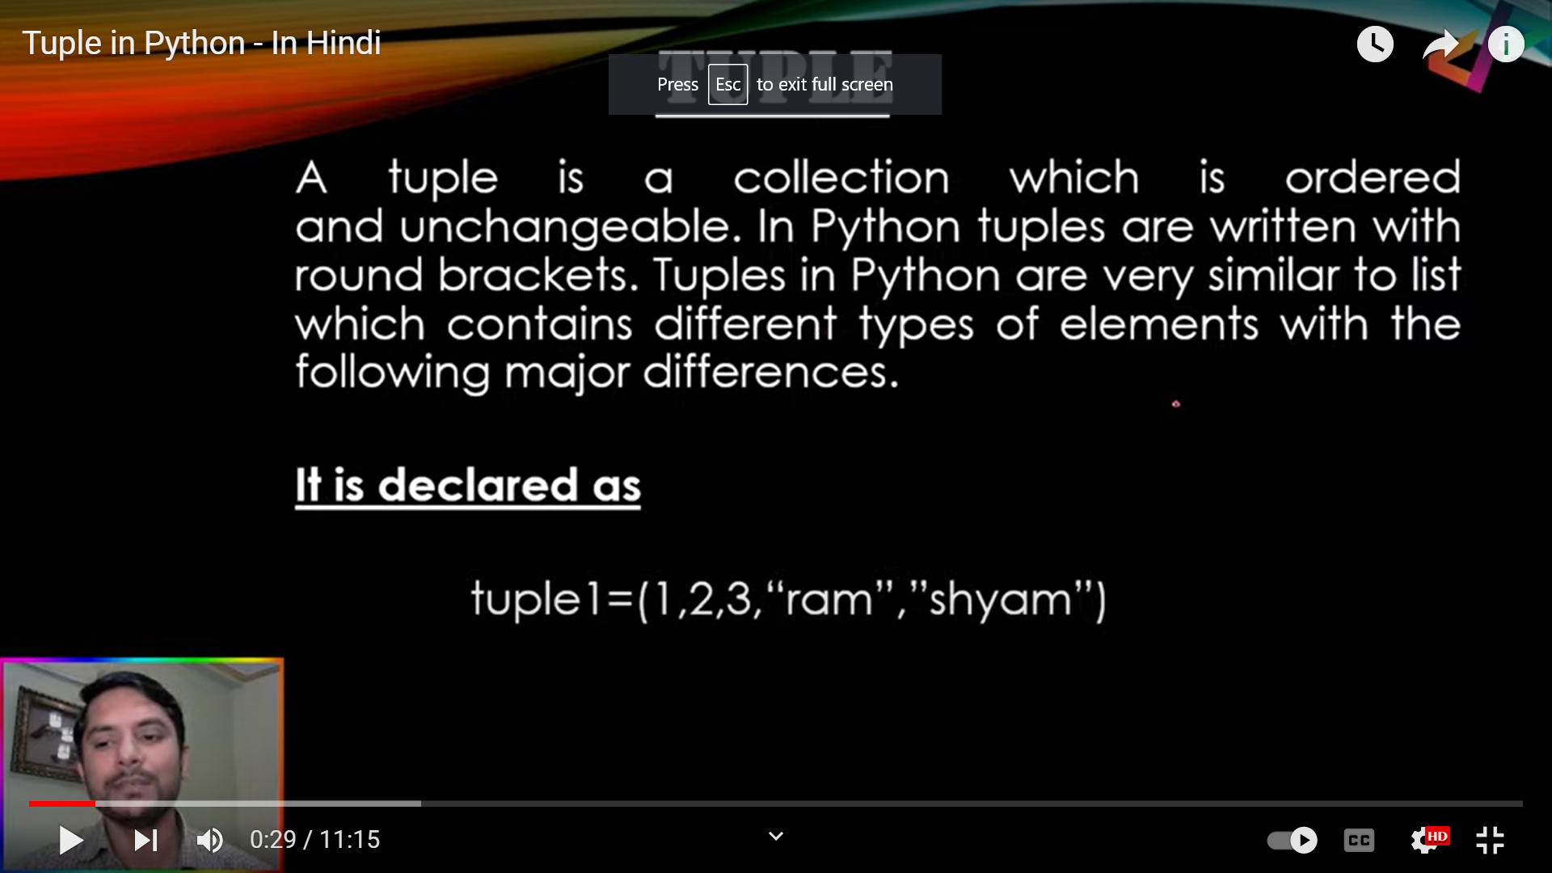

Slide 3
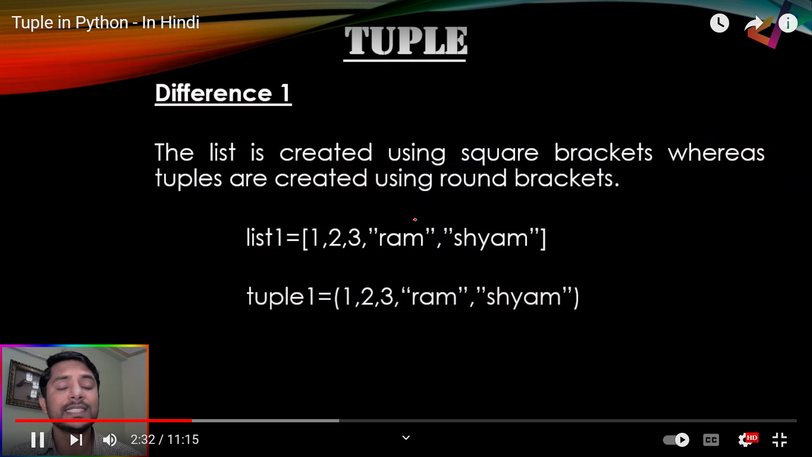

Slide 4
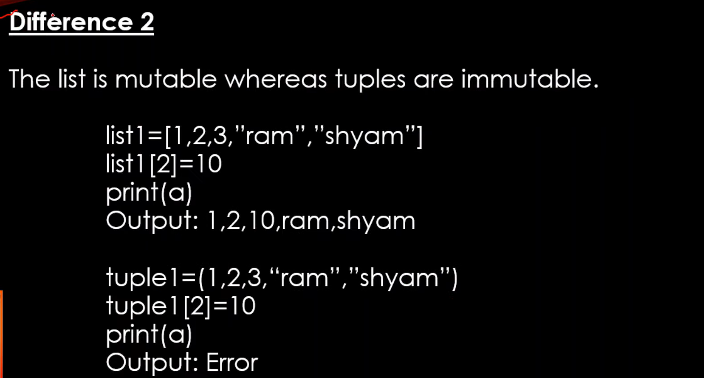

Slide 5
Python Tuples
Tuple is a collection of Python objects much like a list.
Tuples are used to store multiple items in a single variable.
Tuple is one of 4 built-in data types in Python used to store collections of data, the other 3 are List, Set, and Dictionary, all with different qualities and usage.
A tuple is a collection which is ordered and unchangeable.
Tuples are written with round brackets.
Tuples are denoted by parentheses instead of square brackets.
Example: nums = (10, 20, 30)
student = ('John Smith', 48, 'Computer Science’, 3.42)

Slide 6
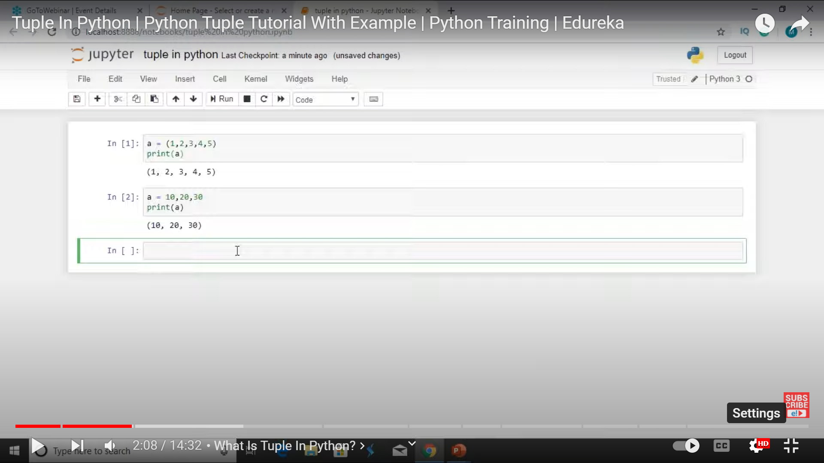

Slide 7
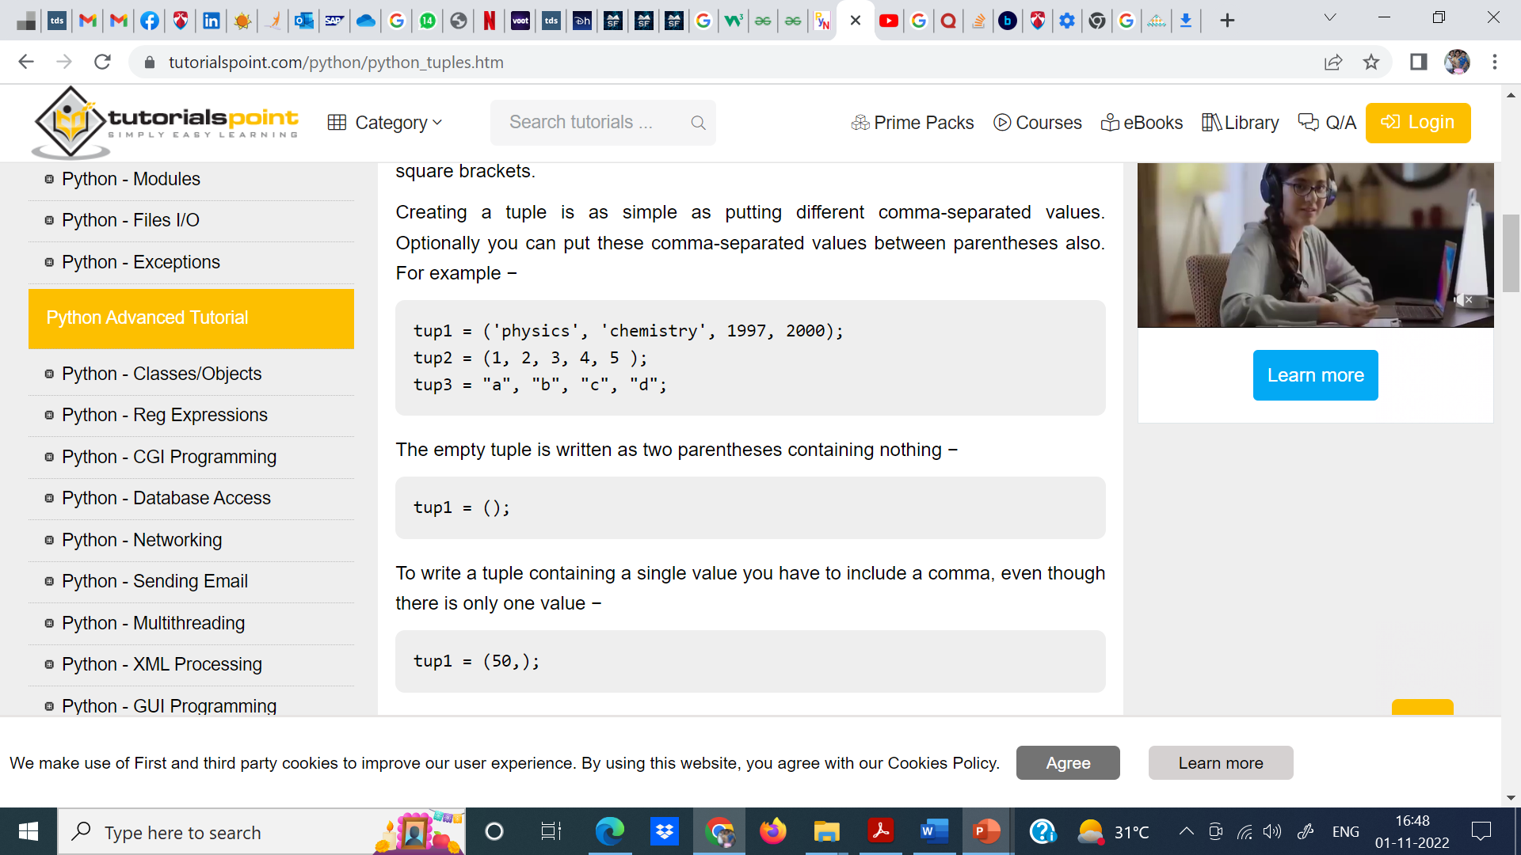

Slide 8
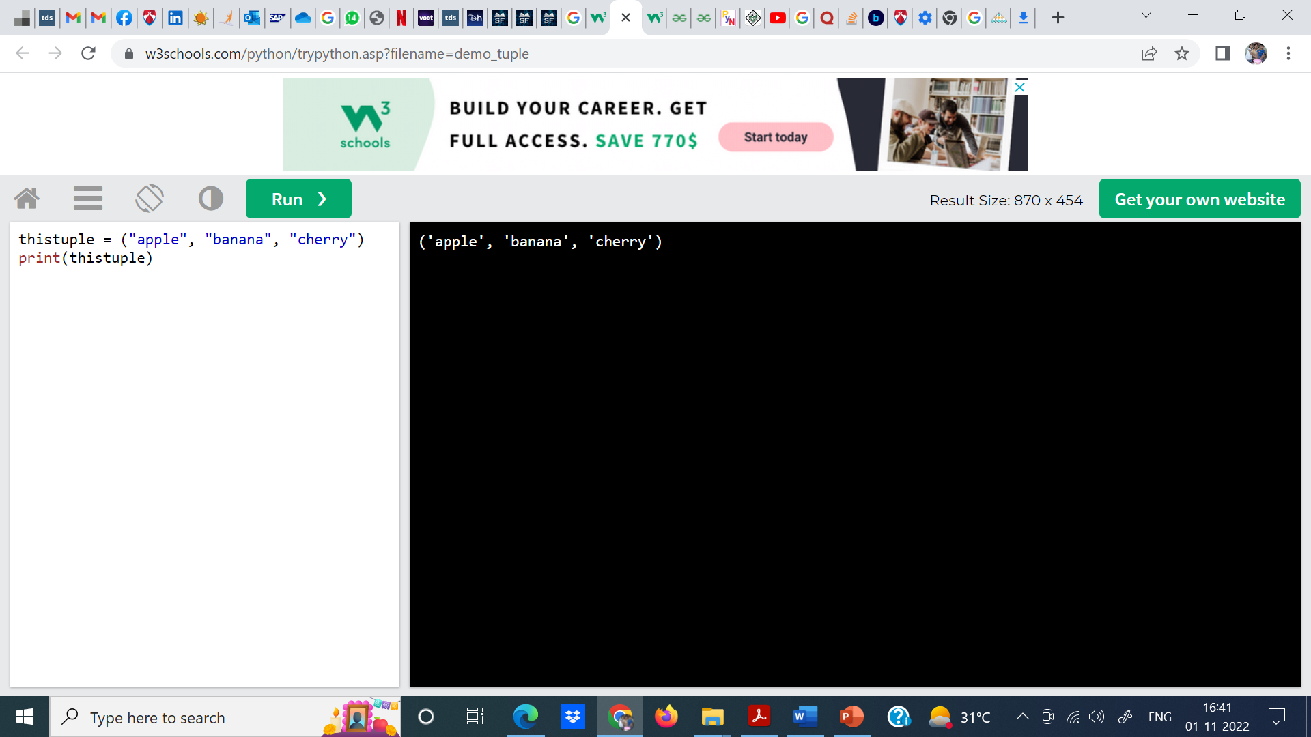
Example
Create a Tuple:
thistuple =("apple", "banana", "cherry") print(thistuple)

Slide 9
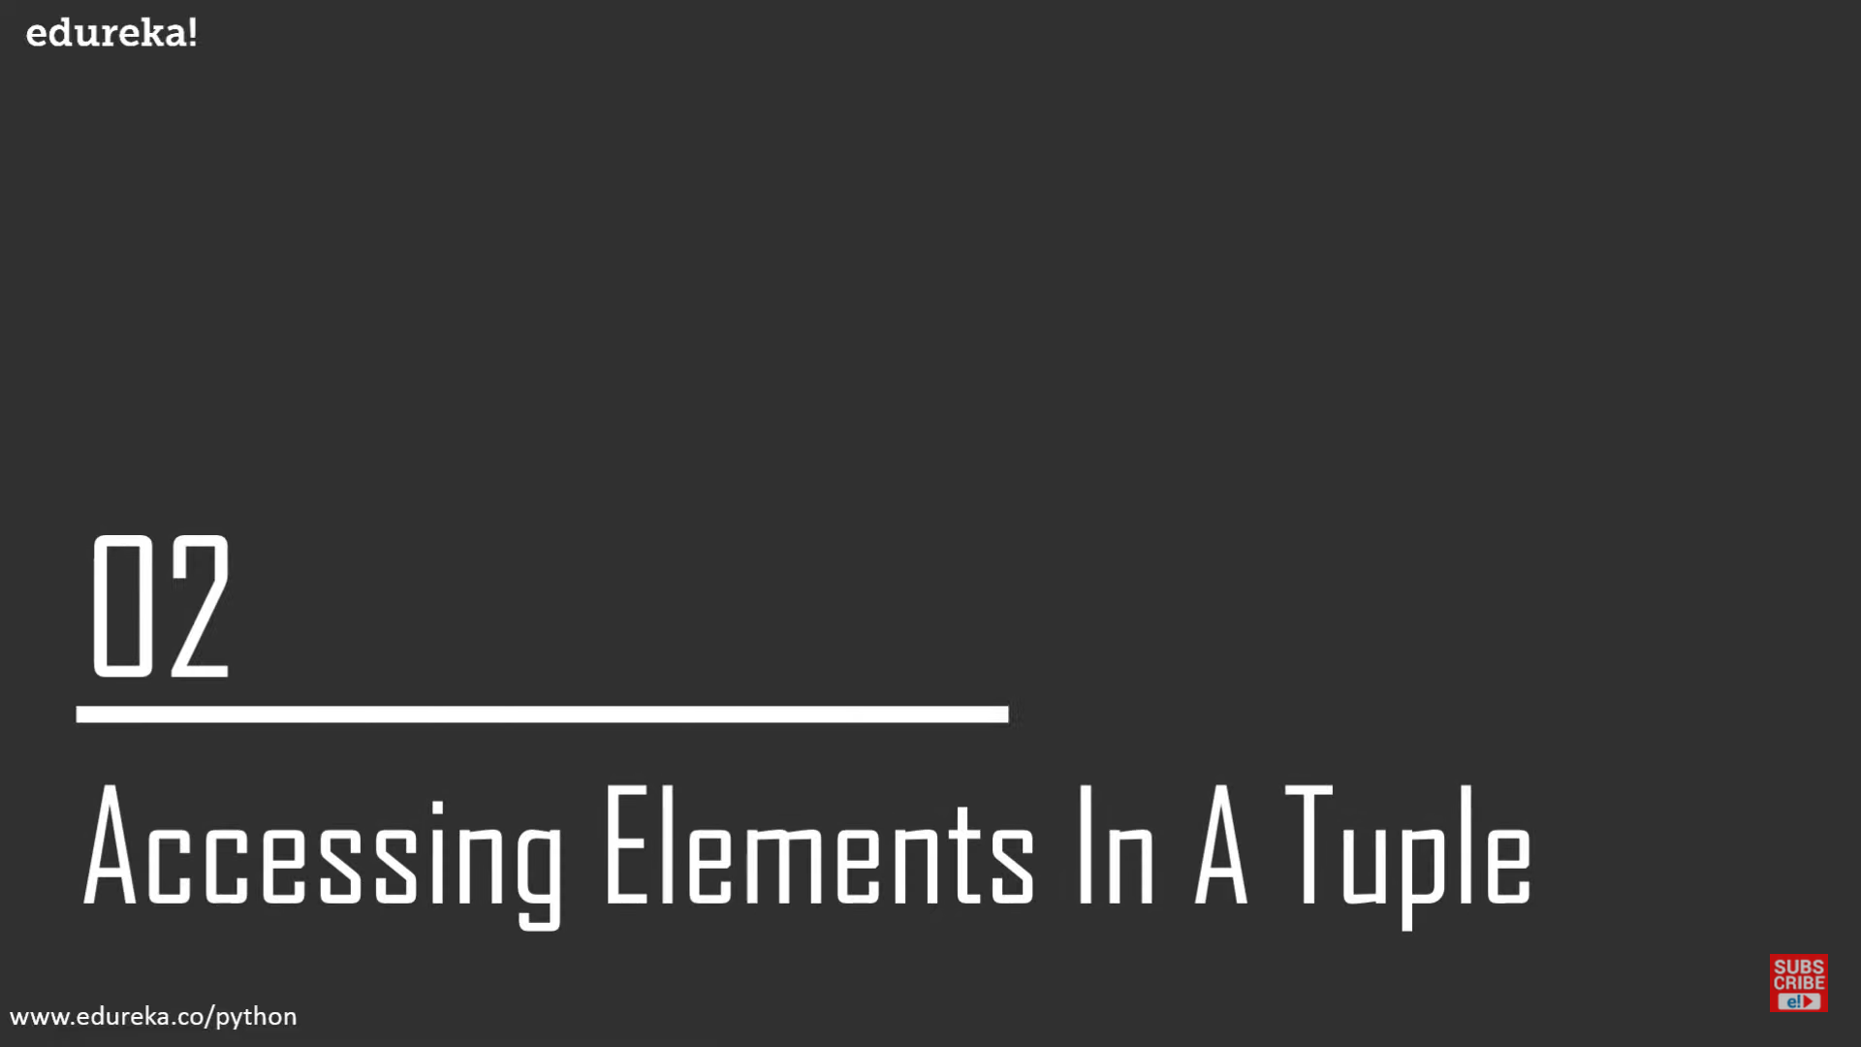

Slide 10
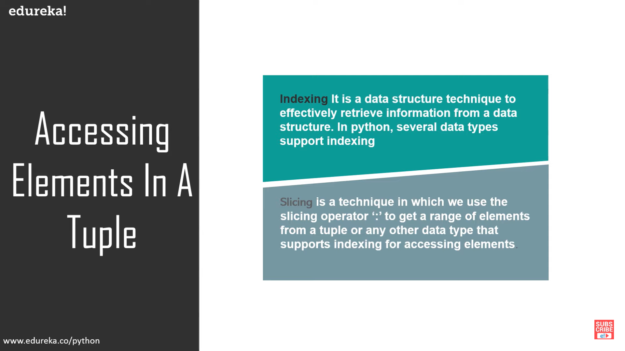

Slide 11
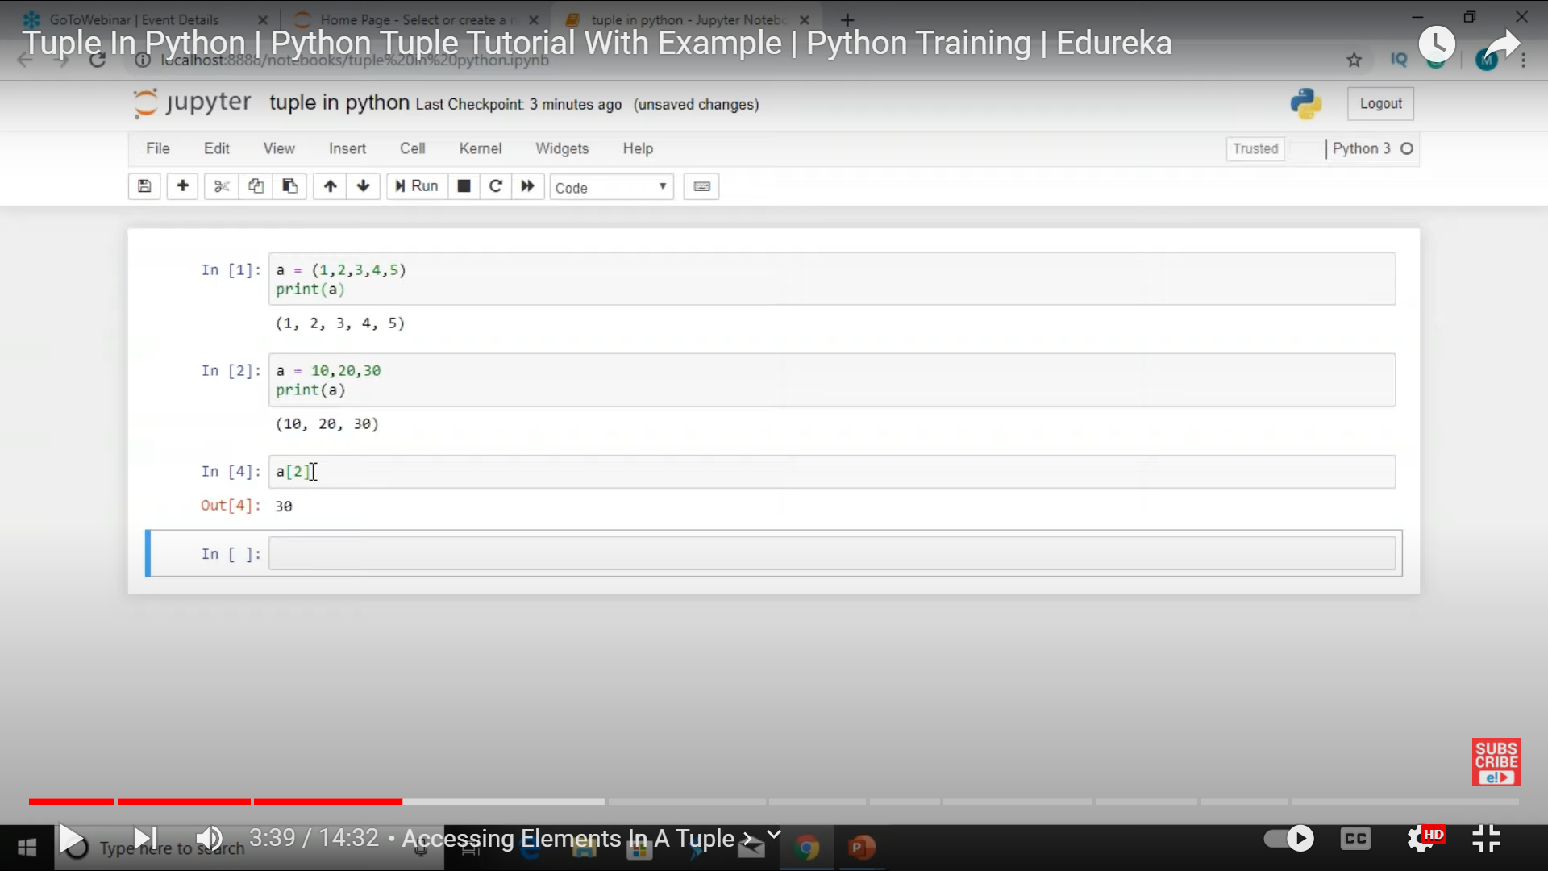

Slide 12
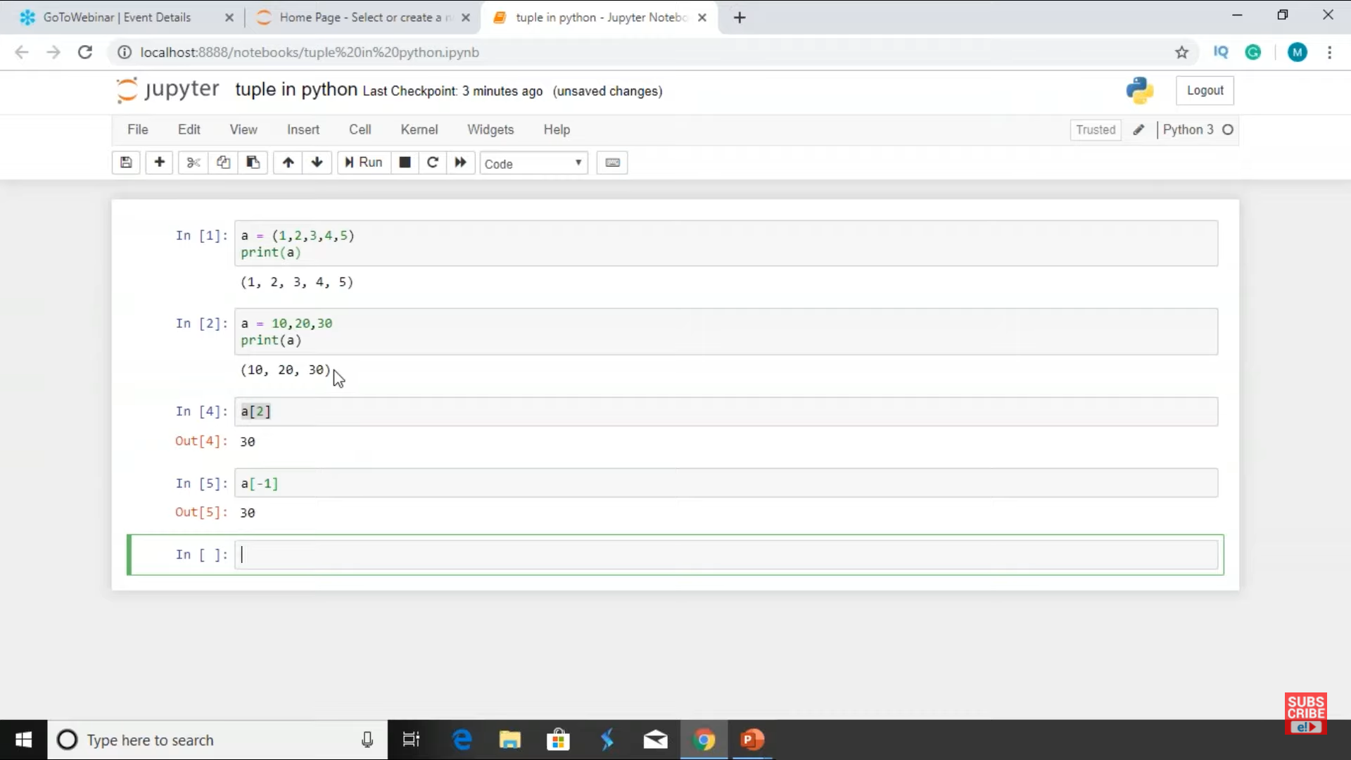

Slide 13
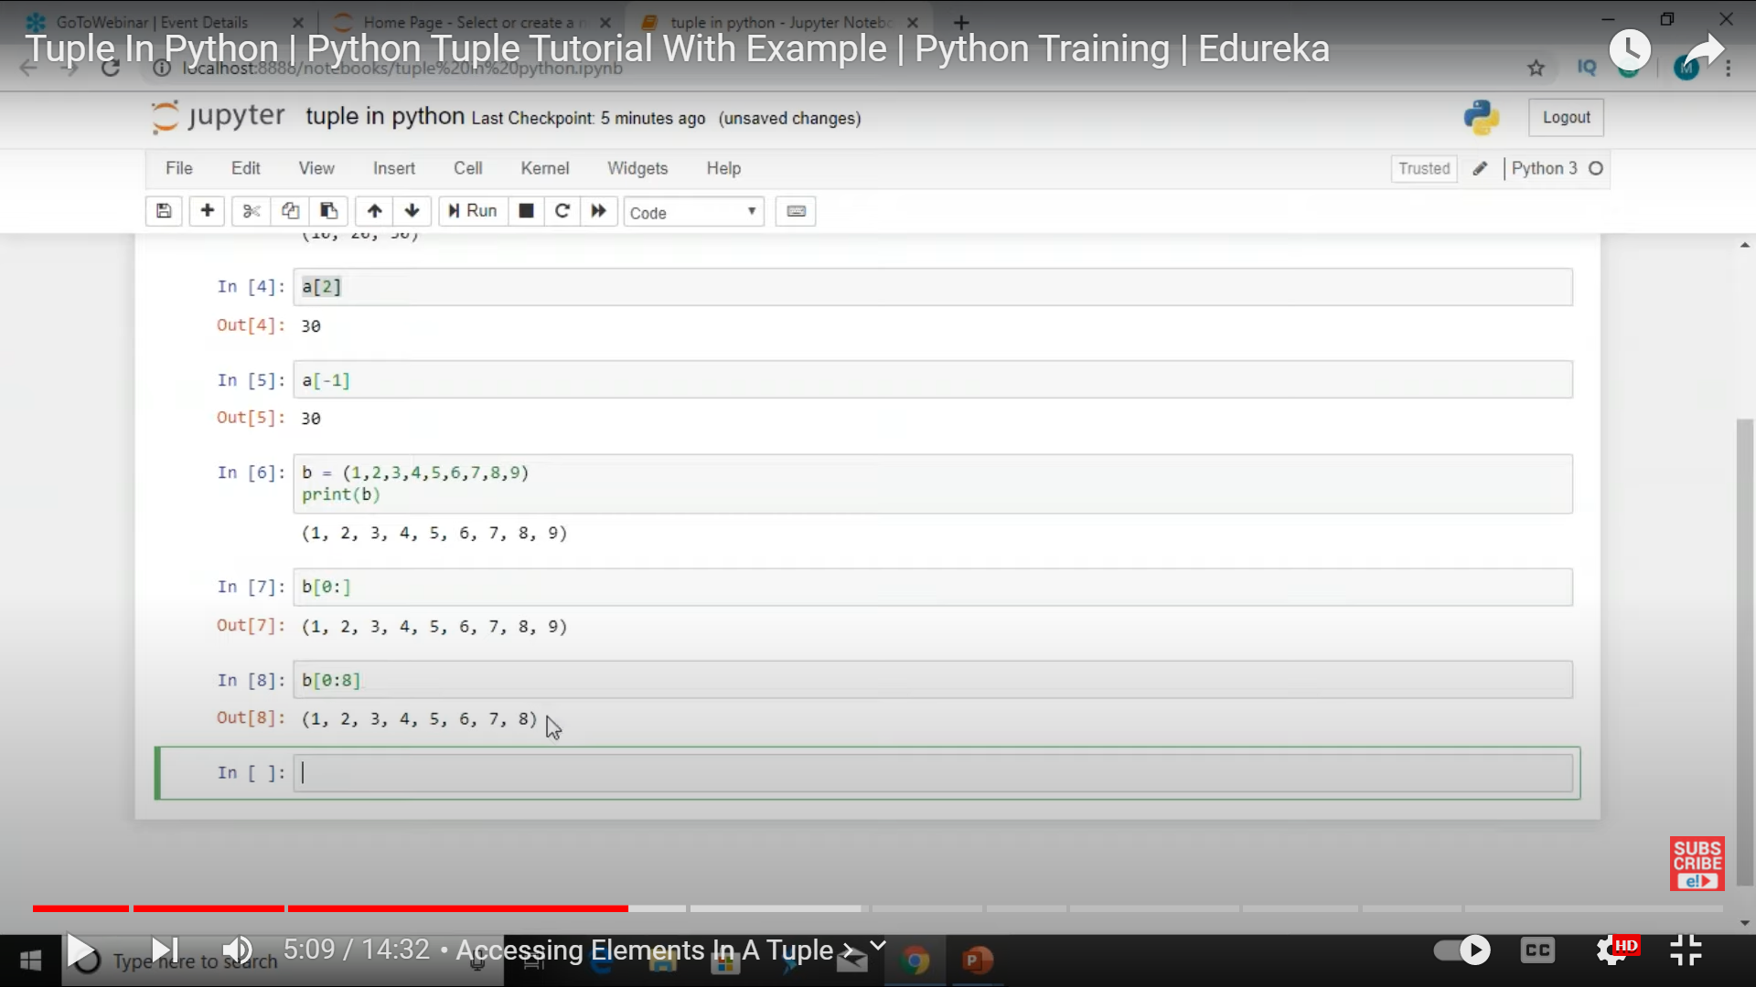

Slide 14
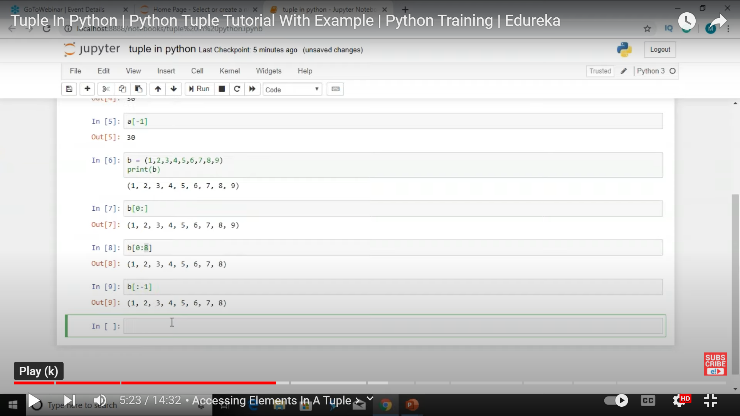

Slide 15
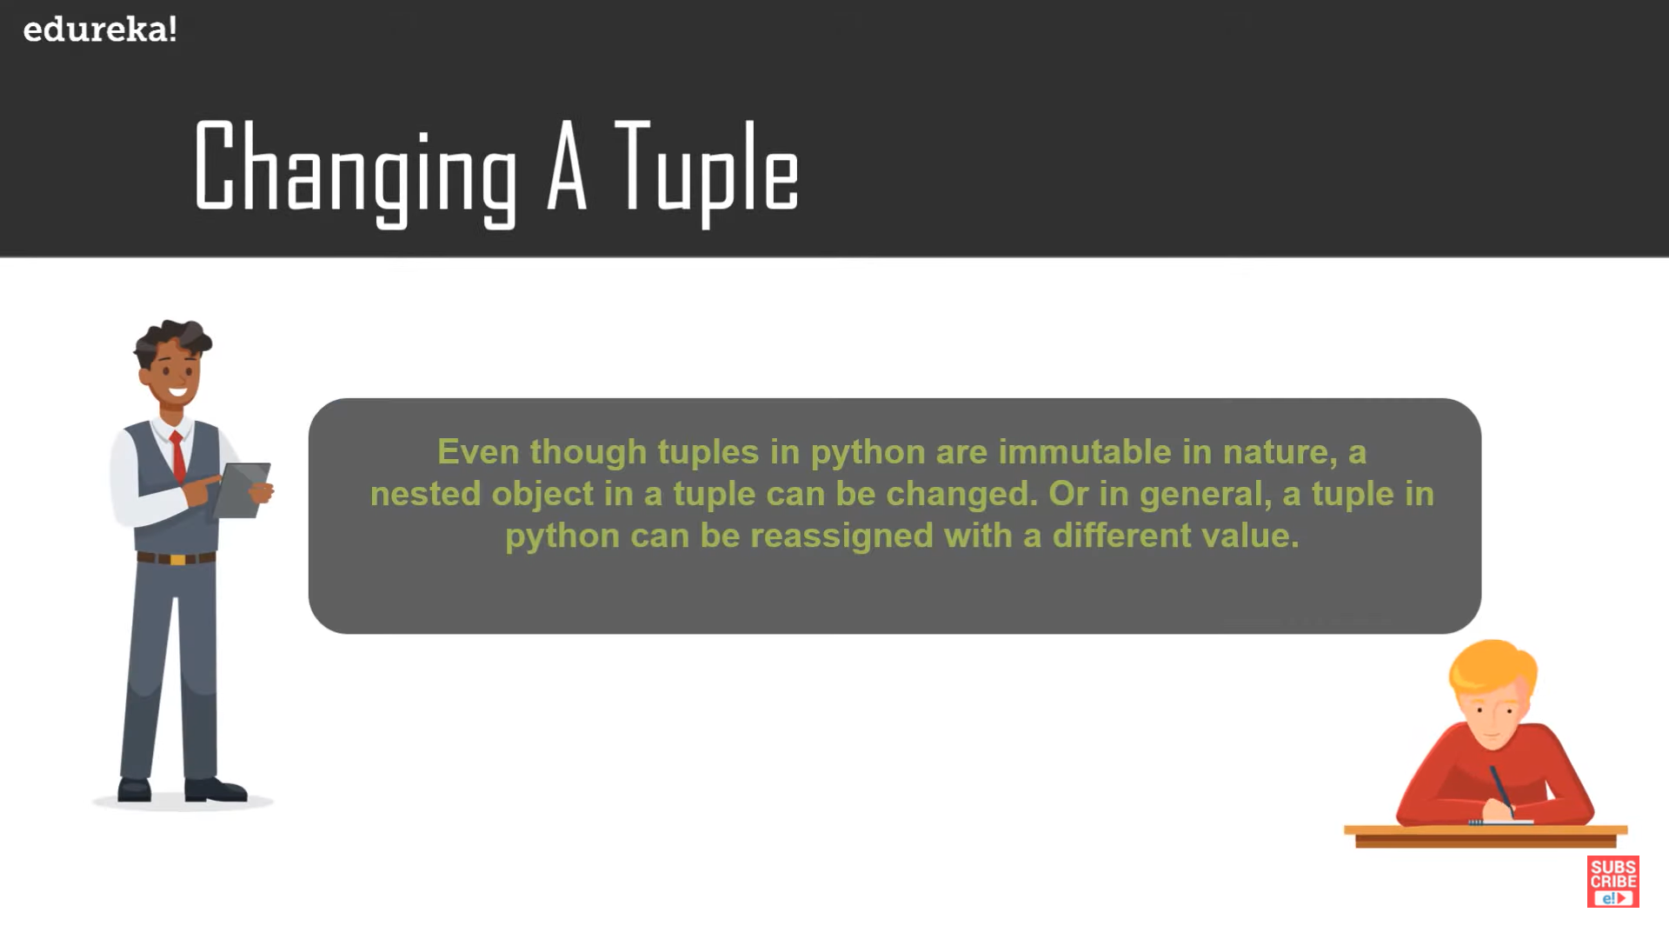

Slide 16
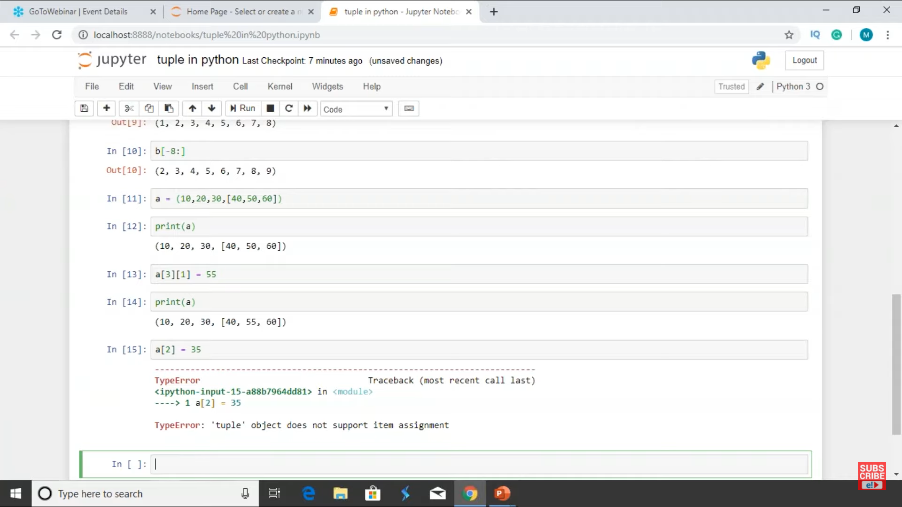

Slide 17
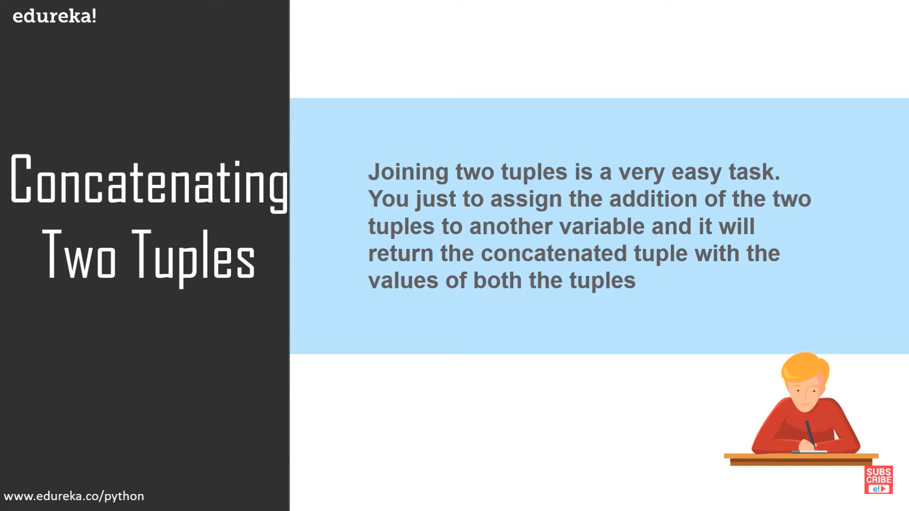

Slide 18
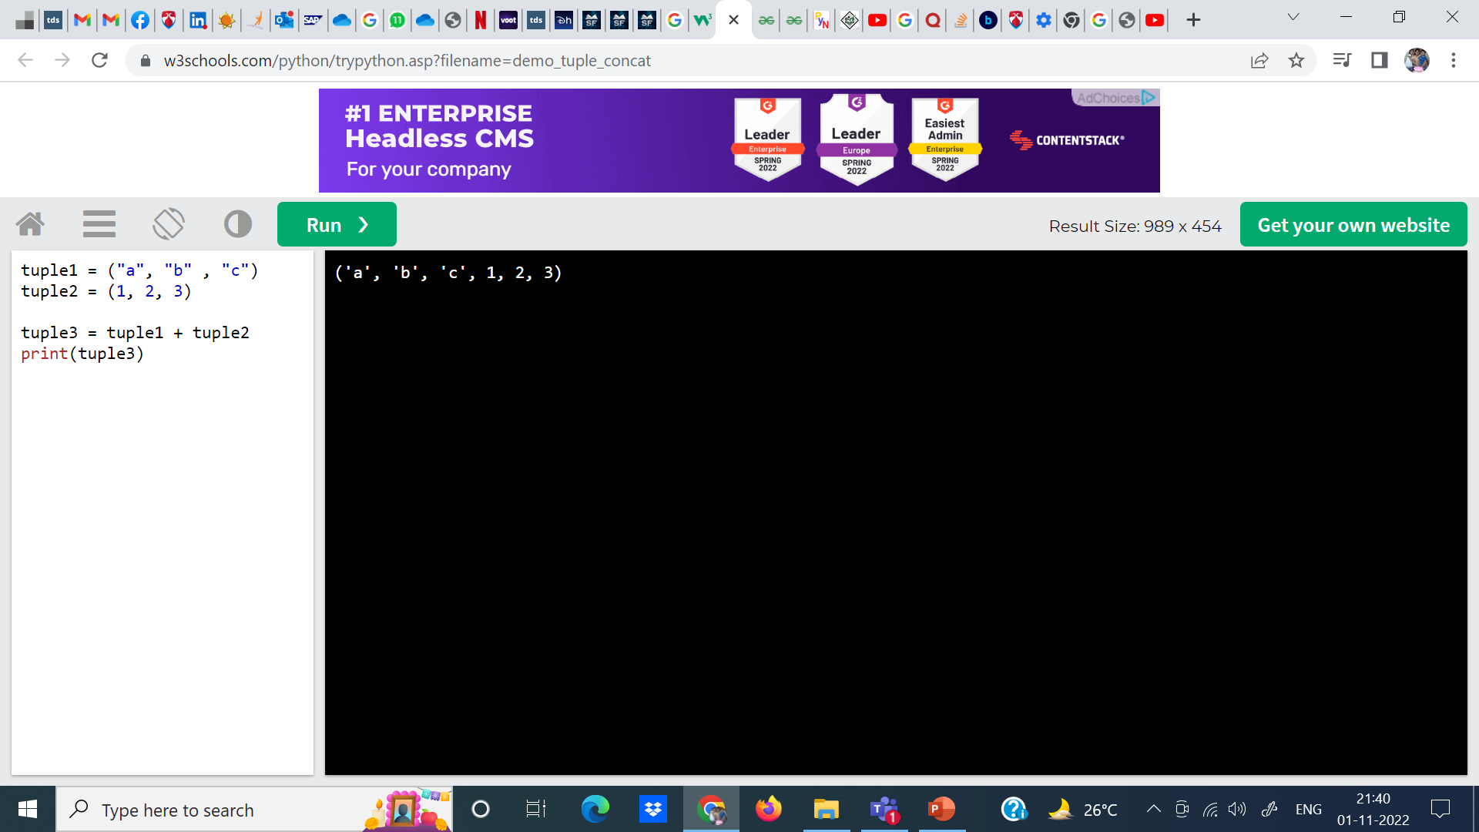

Slide 19
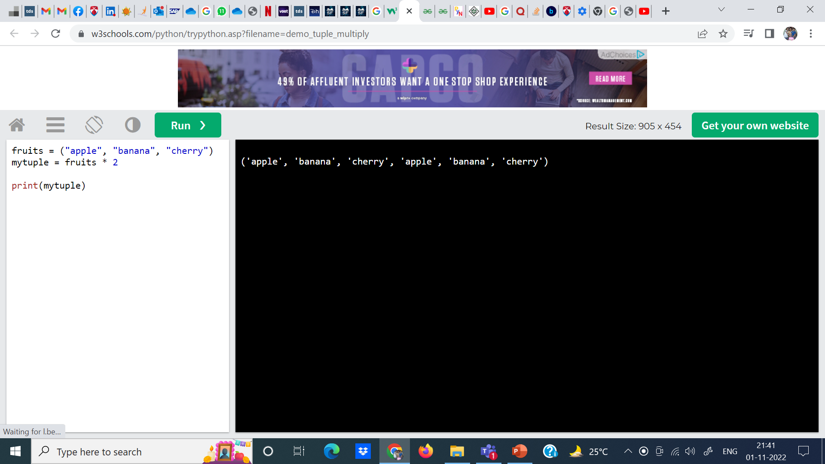

Slide 20
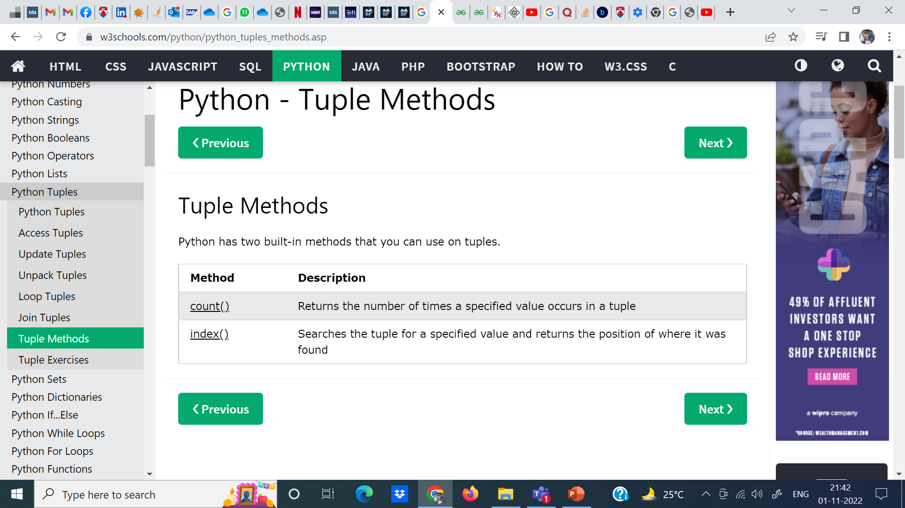

Slide 21
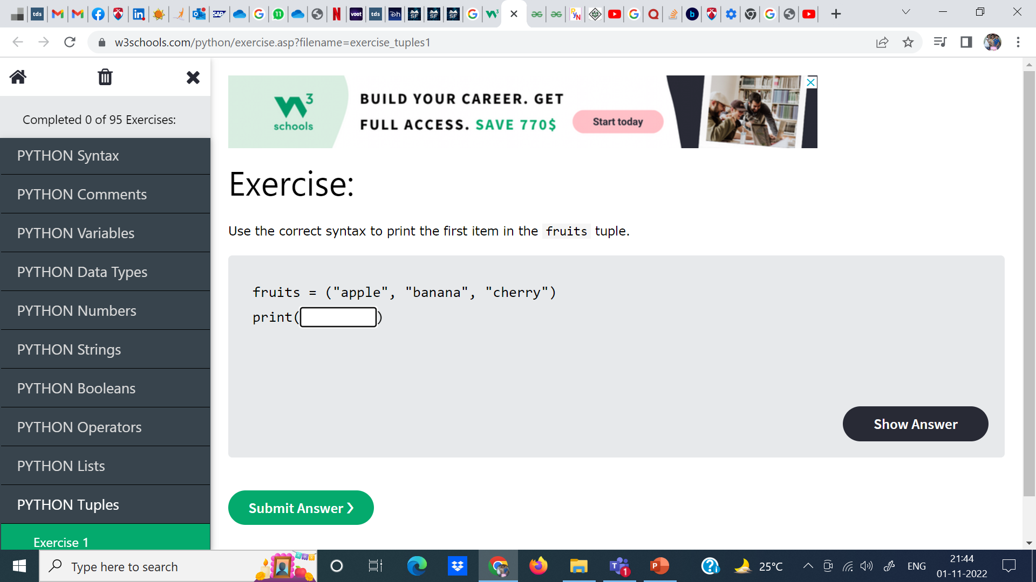
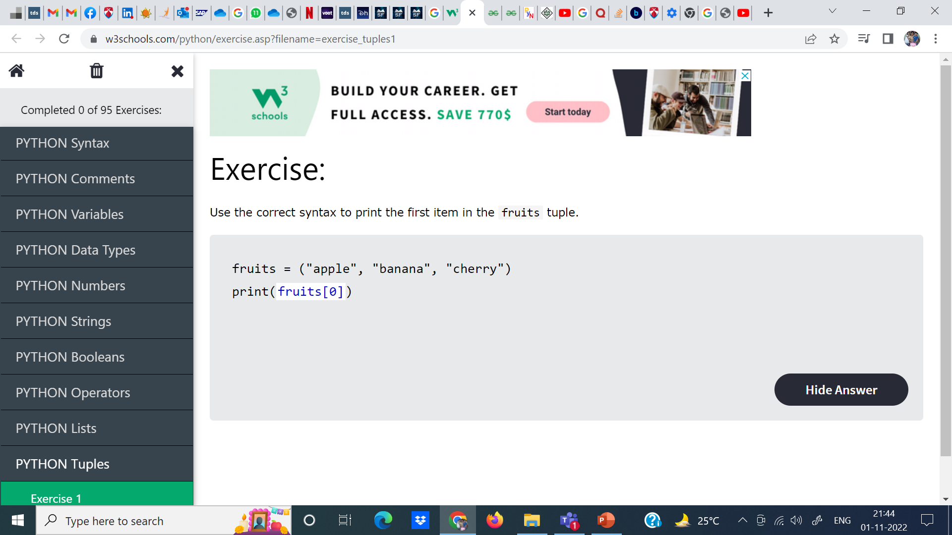

Slide 22
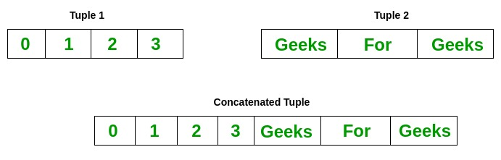
Output:
Tuple 1:
(0, 1, 2, 3)
Tuple2:
('Geeks', 'For', 'Geeks')
Tuples after Concatenation:
(0, 1, 2, 3, 'Geeks', 'For', 'Geeks')

Slide 23
# Concatenation of tuples
Tuple1 = (0, 1, 2, 3)
Tuple2 = ('Geeks', 'For', 'Geeks')
Tuple3 = Tuple1 + Tuple2
# Printing first Tuple
print("Tuple 1: ")
print(Tuple1)
# Printing Second Tuple
print("\nTuple2: ")
print(Tuple2)
# Printing Final Tuple
print("\nTuples after Concatenation: ")
print(Tuple3)

Slide 24
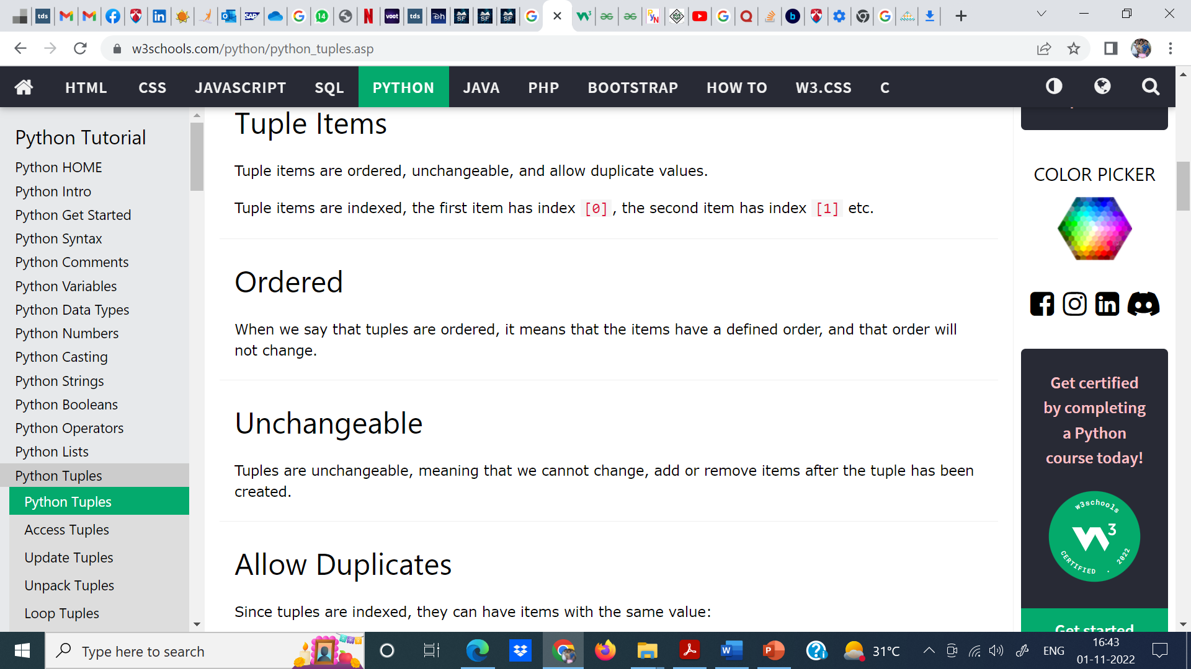

Slide 25
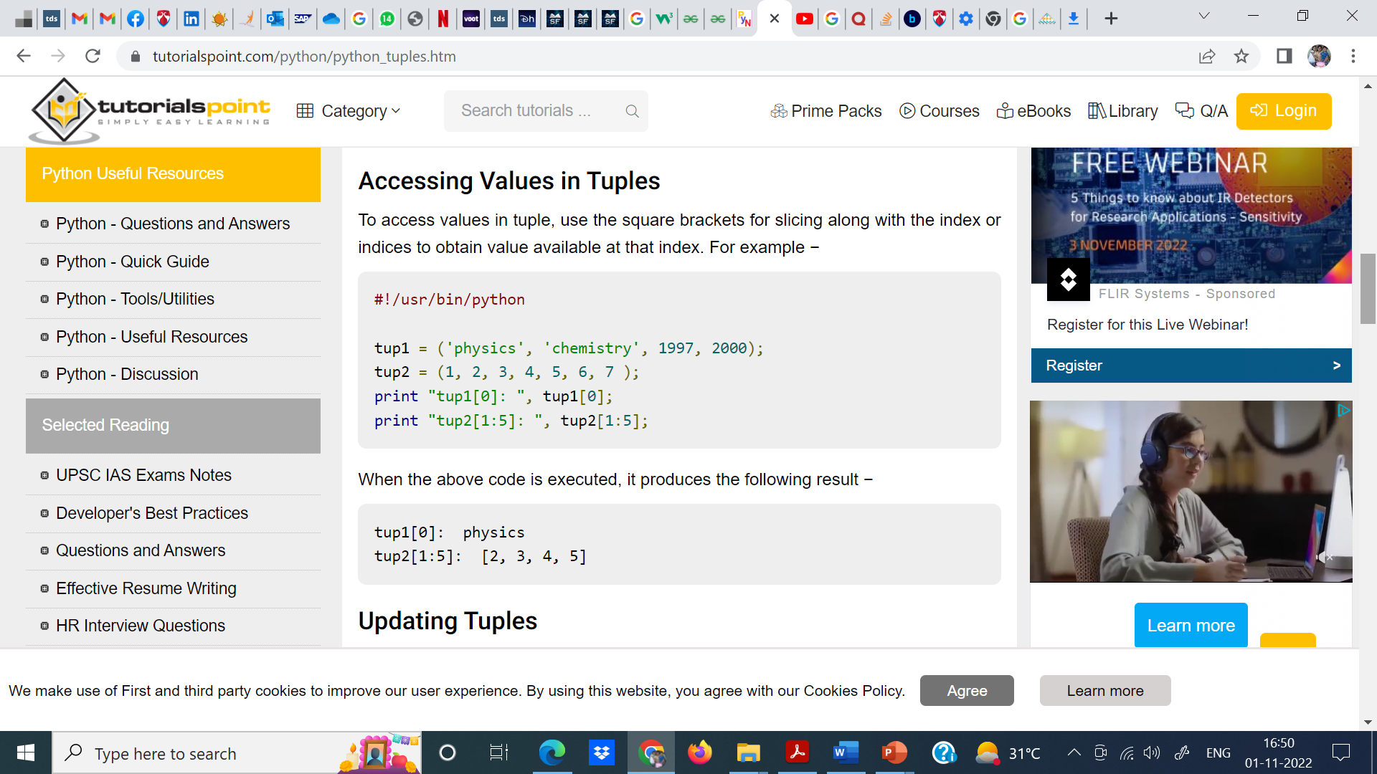

Slide 26
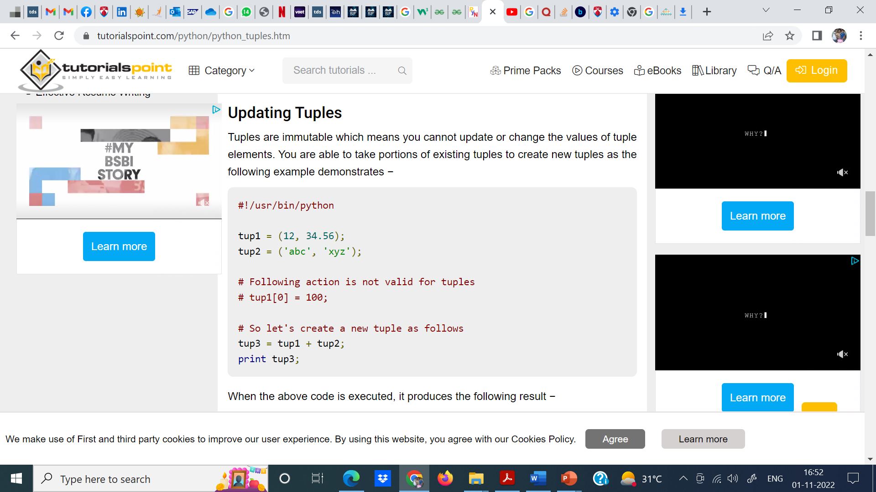

Slide 27
When the above code is executed, it produces the following result −
(12, 34.56, 'abc', 'xyz')

Slide 28
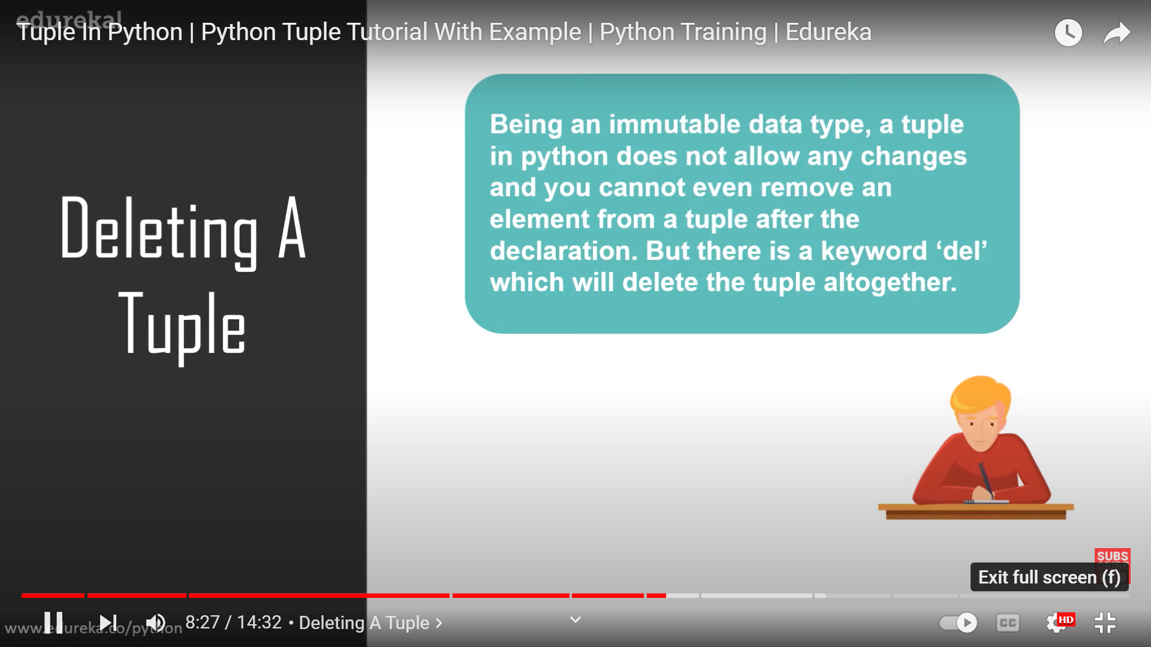

Slide 29
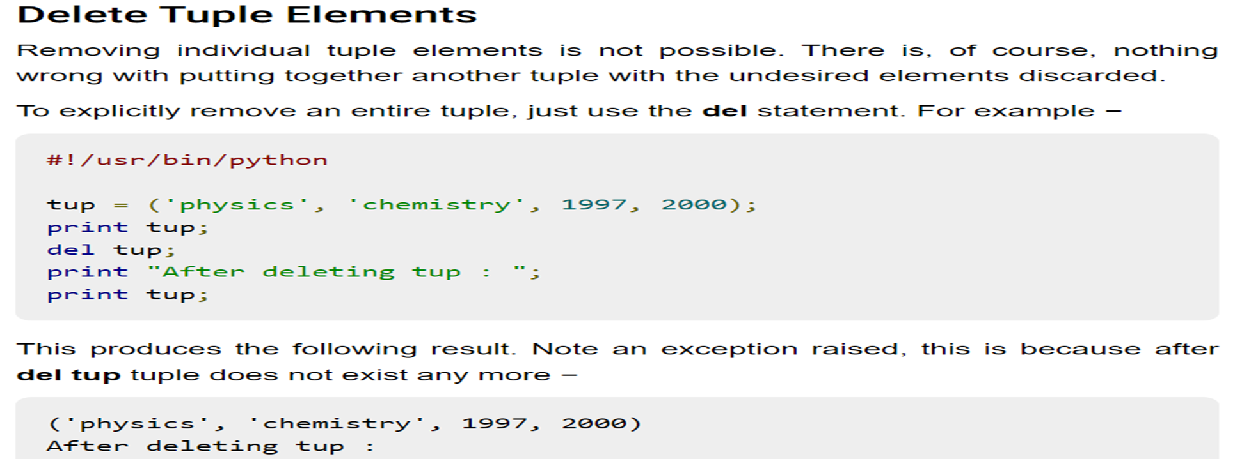

Slide 30
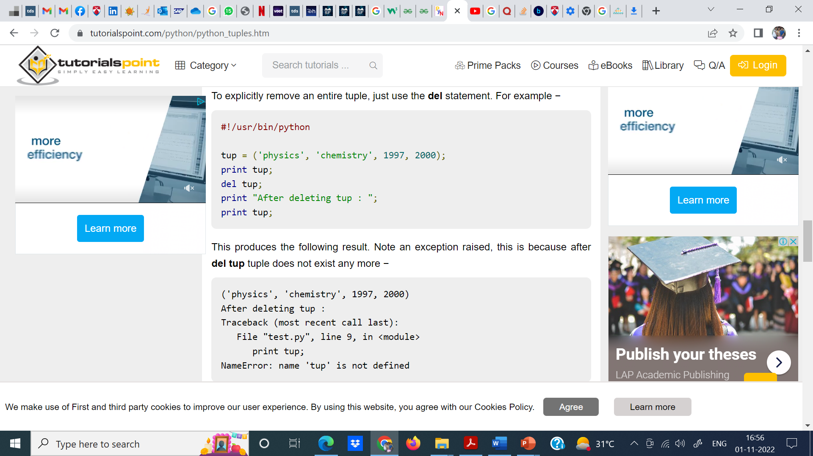

Slide 31
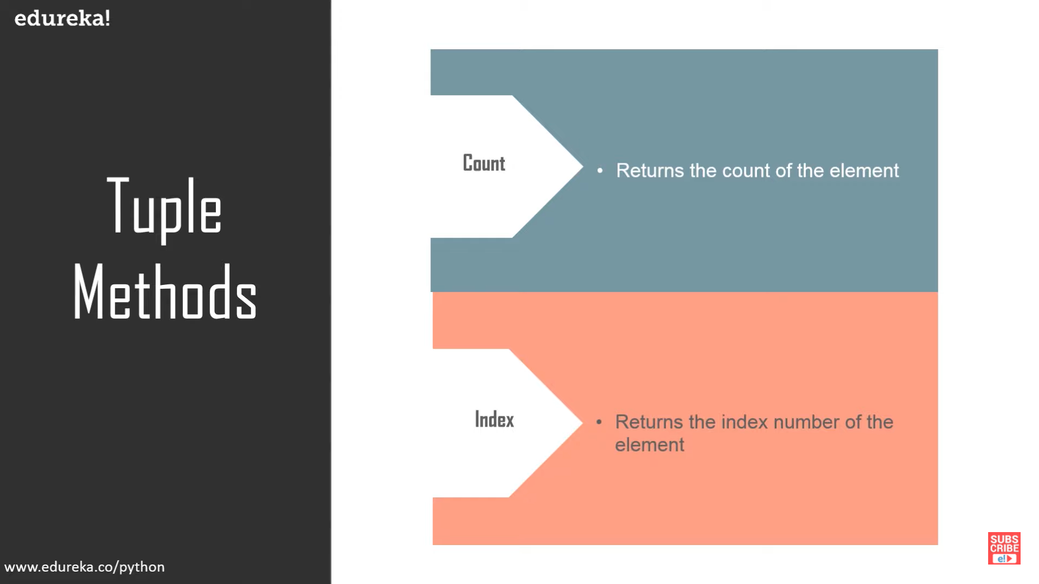

Slide 32
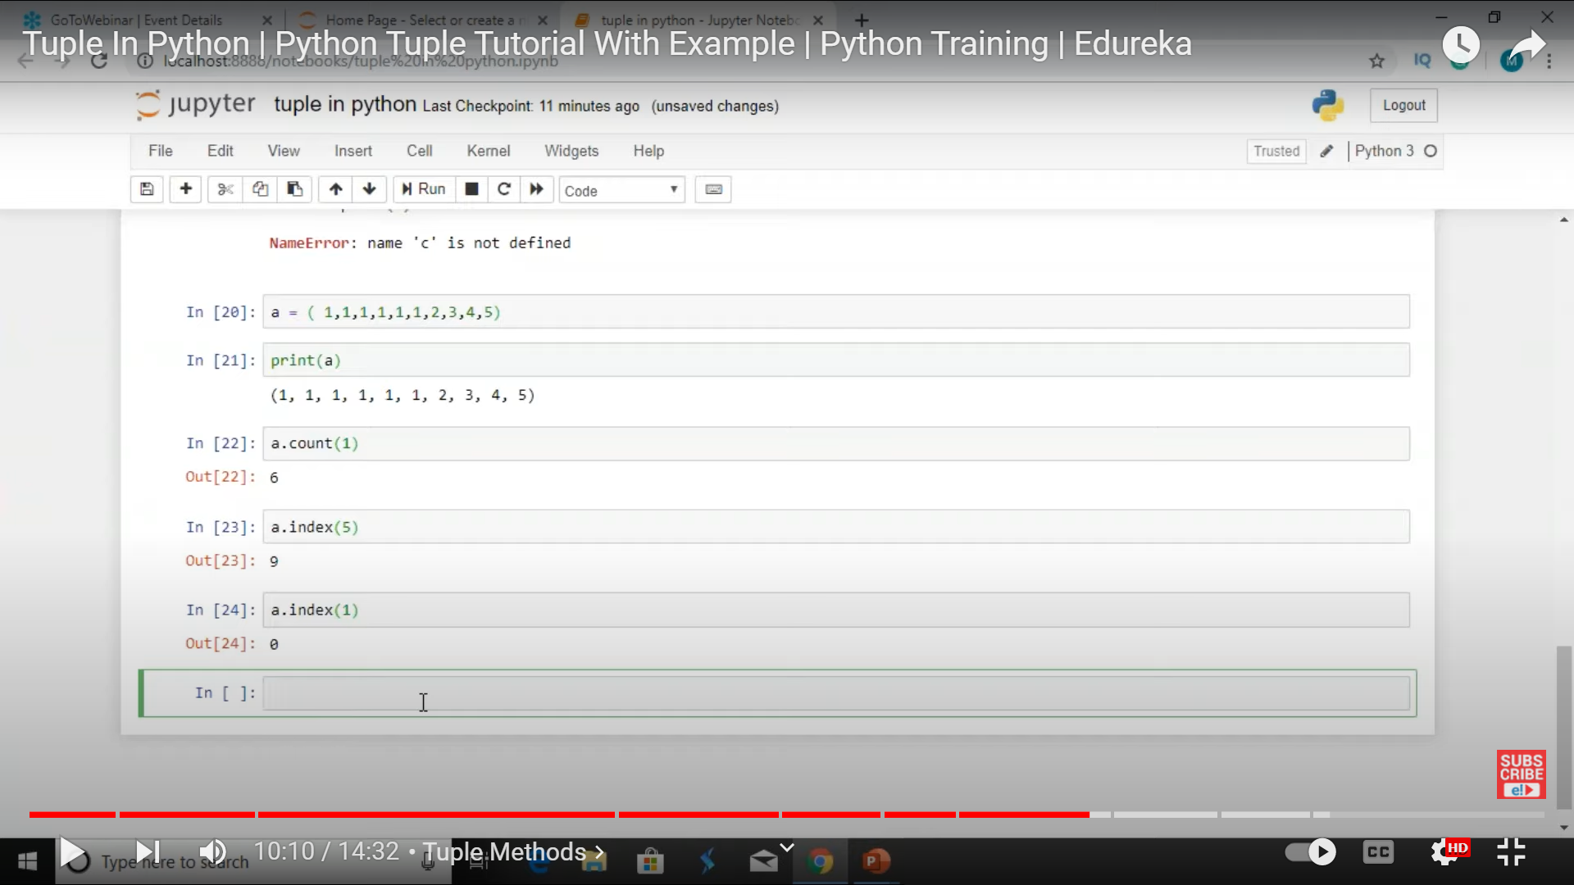

Slide 33
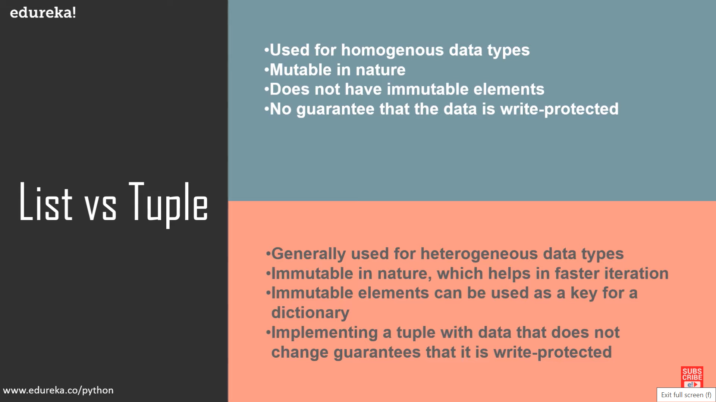

Slide 34
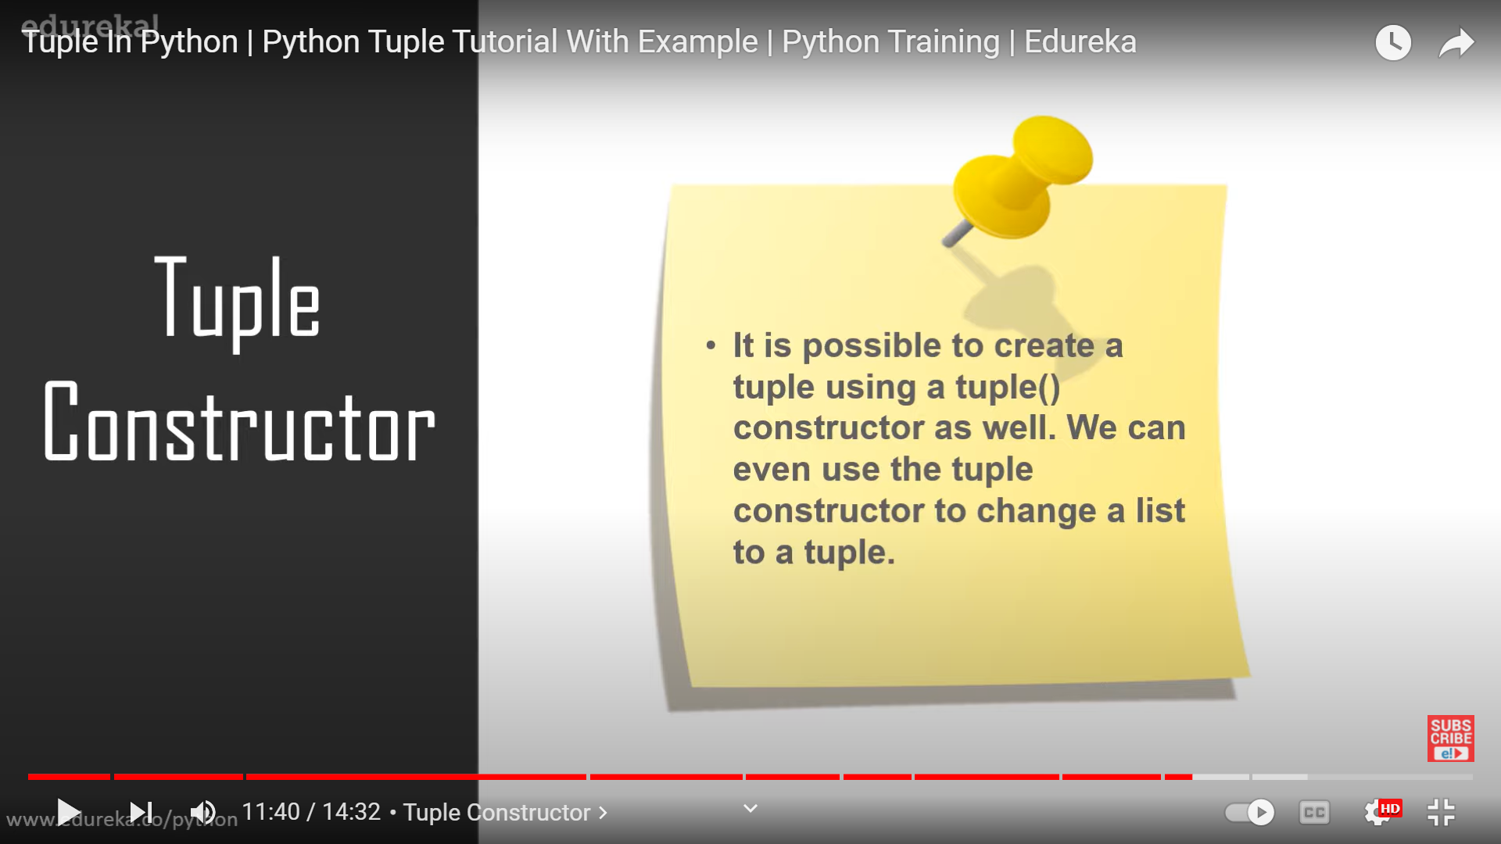

Slide 35
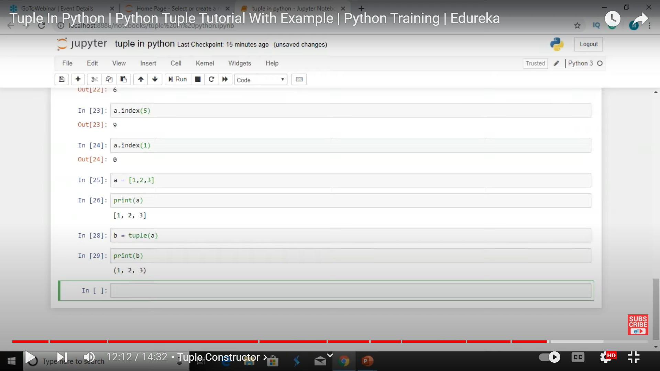

Slide 36
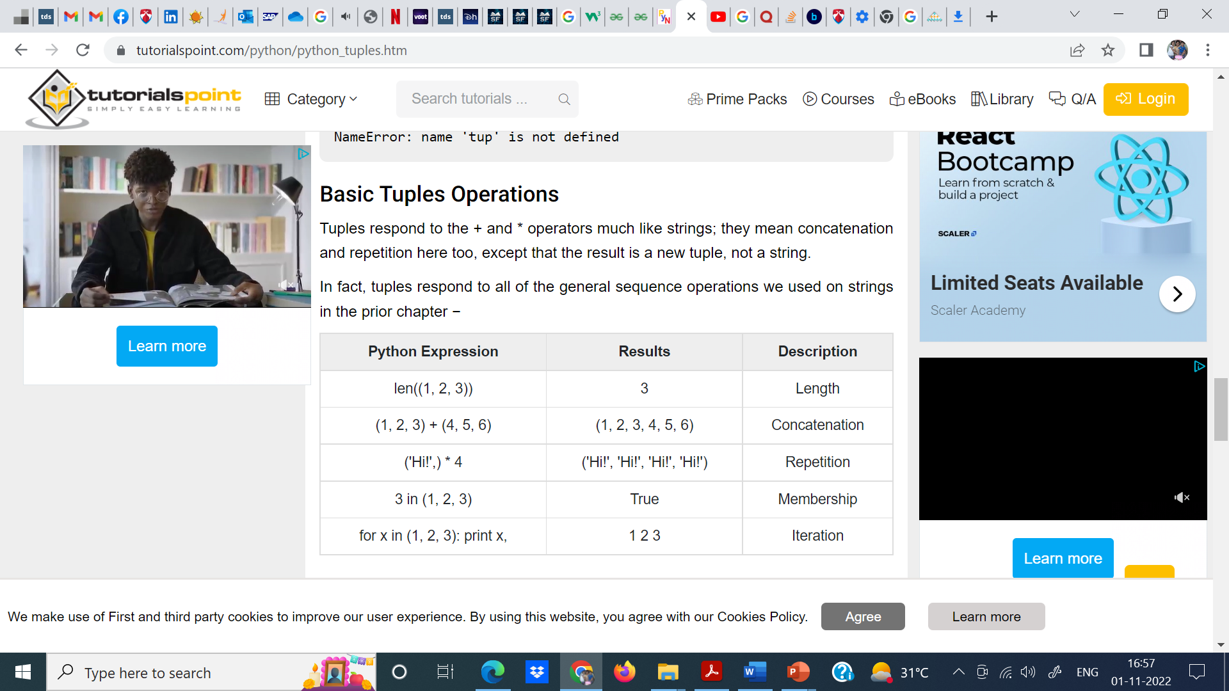

Slide 37
